Slide 1
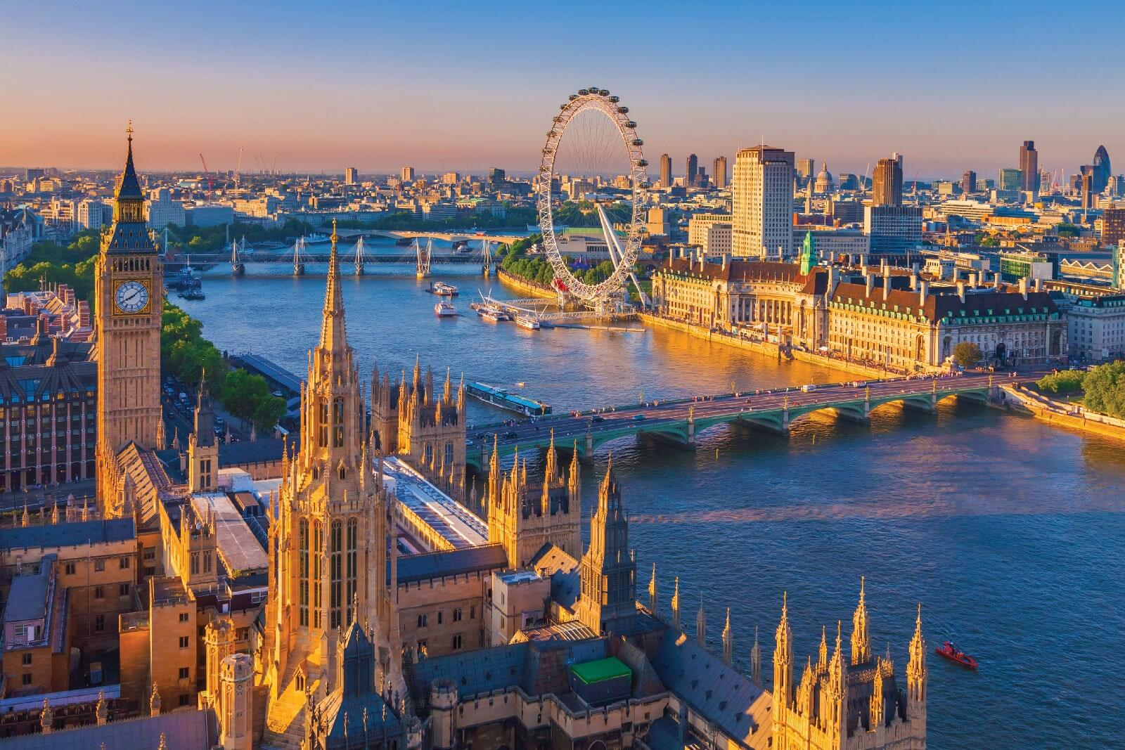
The best place in world!
LONDON

Slide 3
London is situated upon both banks of the River Thames. It is the larges city in Britain and one of the largest in the world.
Its population is about 7 million people.

Slide 4
The West End
The best place of the West End

Slide 5
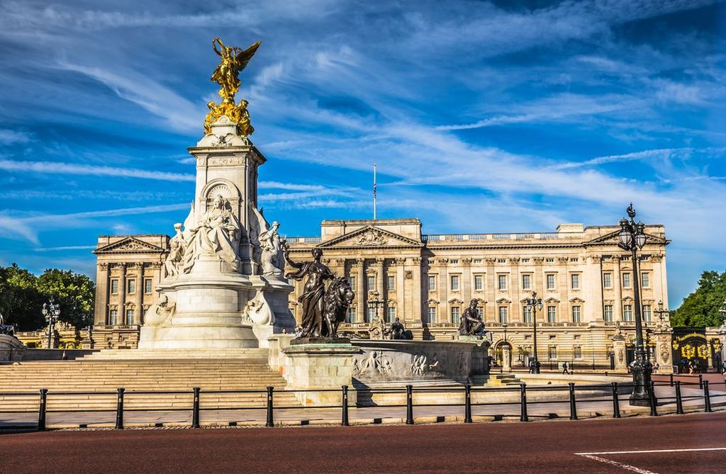
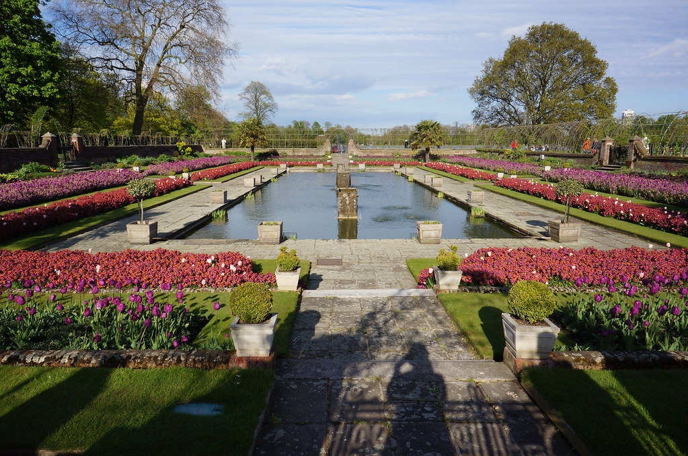
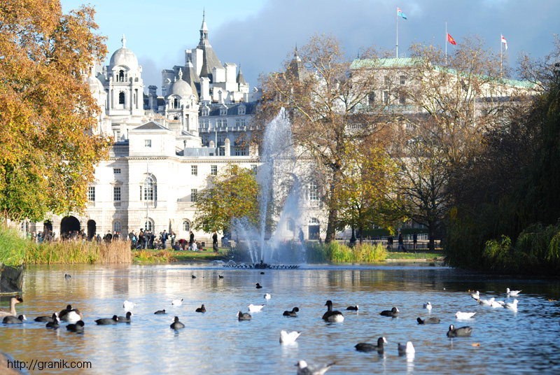
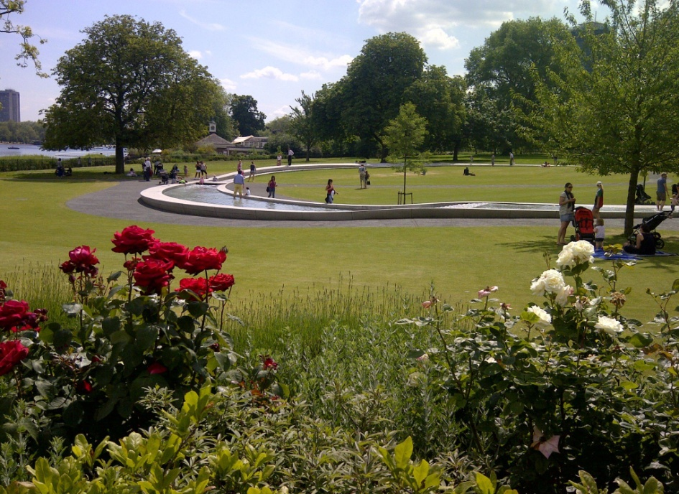

Slide 6
Big Ben
He name Big Ben actually refers not to the clock – tower itself , but to the thirteen ton bell hung within. The bell was named after the commissioner off world . Sir Benjamin Hall.

Slide 7
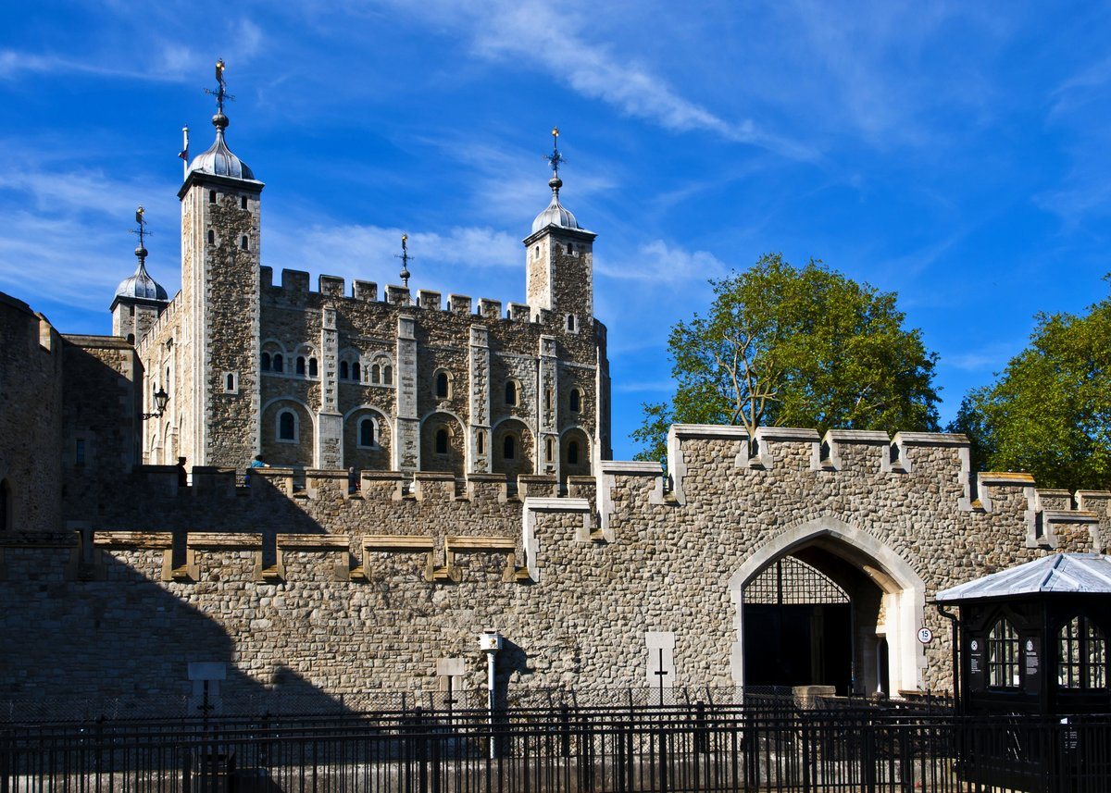
Tower of London
Founded nearly a millennium ago and expanded upon over the centuries since. The Tower of London has protected the city.

